Slide 1
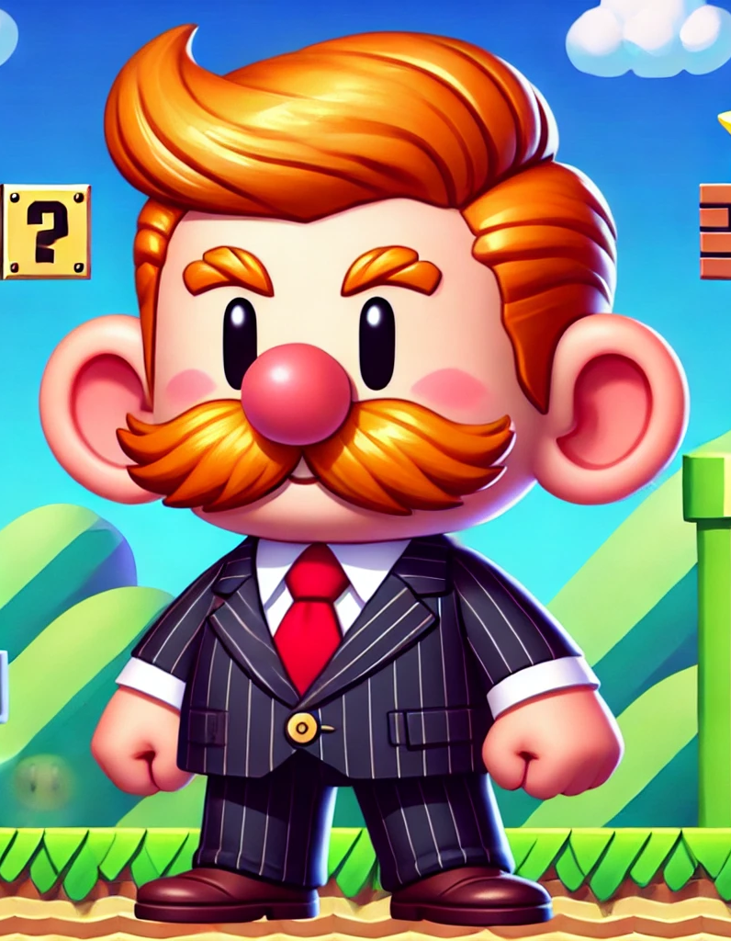

Dennis Trumpet
Nicolas Fernandez

Slide 2
Agenda
1
2
3
4
5
Game Concept
Game Mechanics
Level Design
Art and Style
Code

Slide 3
Game Concept
A satirical platformer video game inspired by Donald Trump’s controversial declarations. The objective of the game is to convert enough protesters into followers and avoid obstacles in order to gain enough support to ascend to power.
Genre: Platformer/Side-scroller

Slide 4
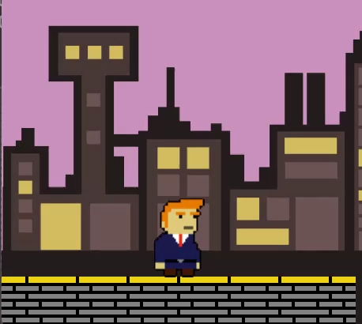
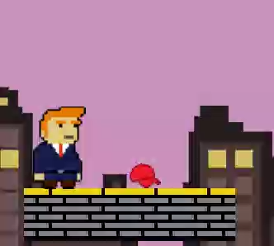
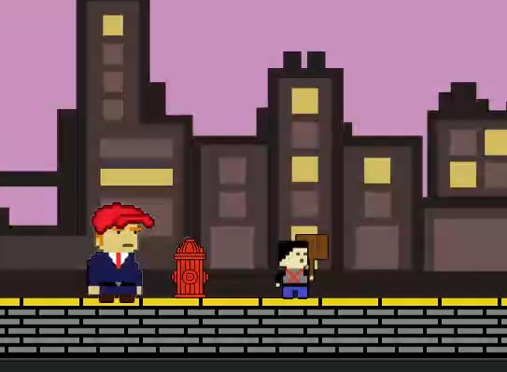
Game Mechanics
Movement
Shooting
Collecting followers
The player controls Dennis Trumpet with the arrow keys or WASD keys.
In order to shoot, the player must collect the “Red Cap” power-up.
Once an enemy is shot by the player, they will start following him.

Slide 5
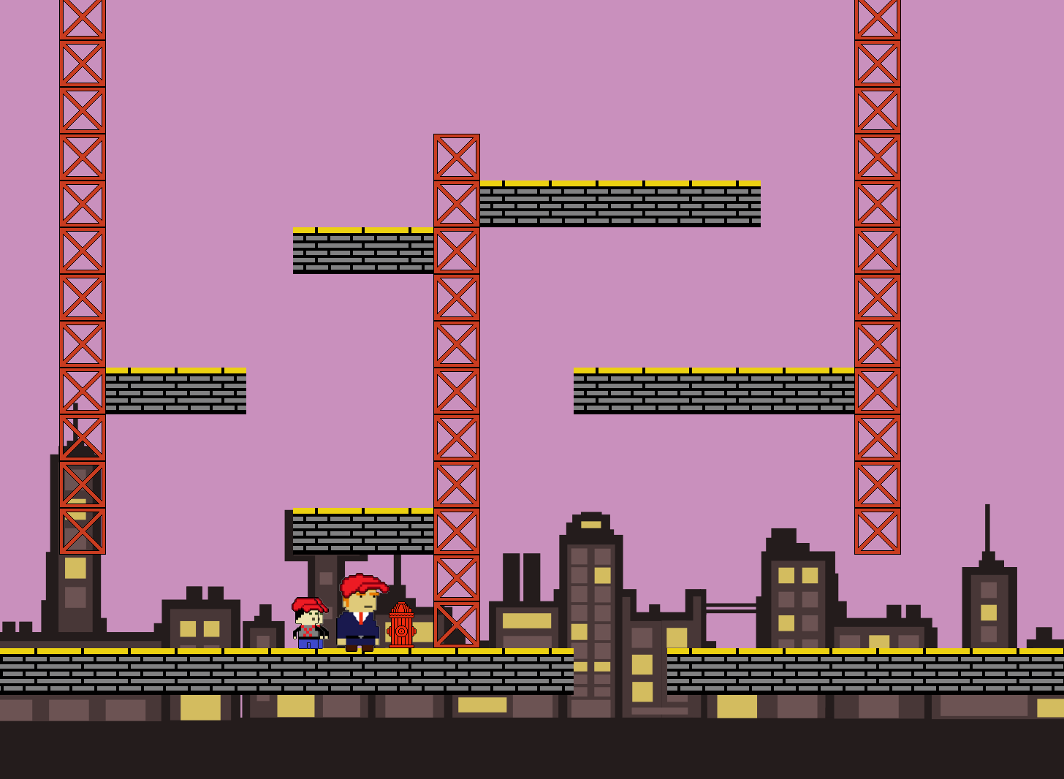
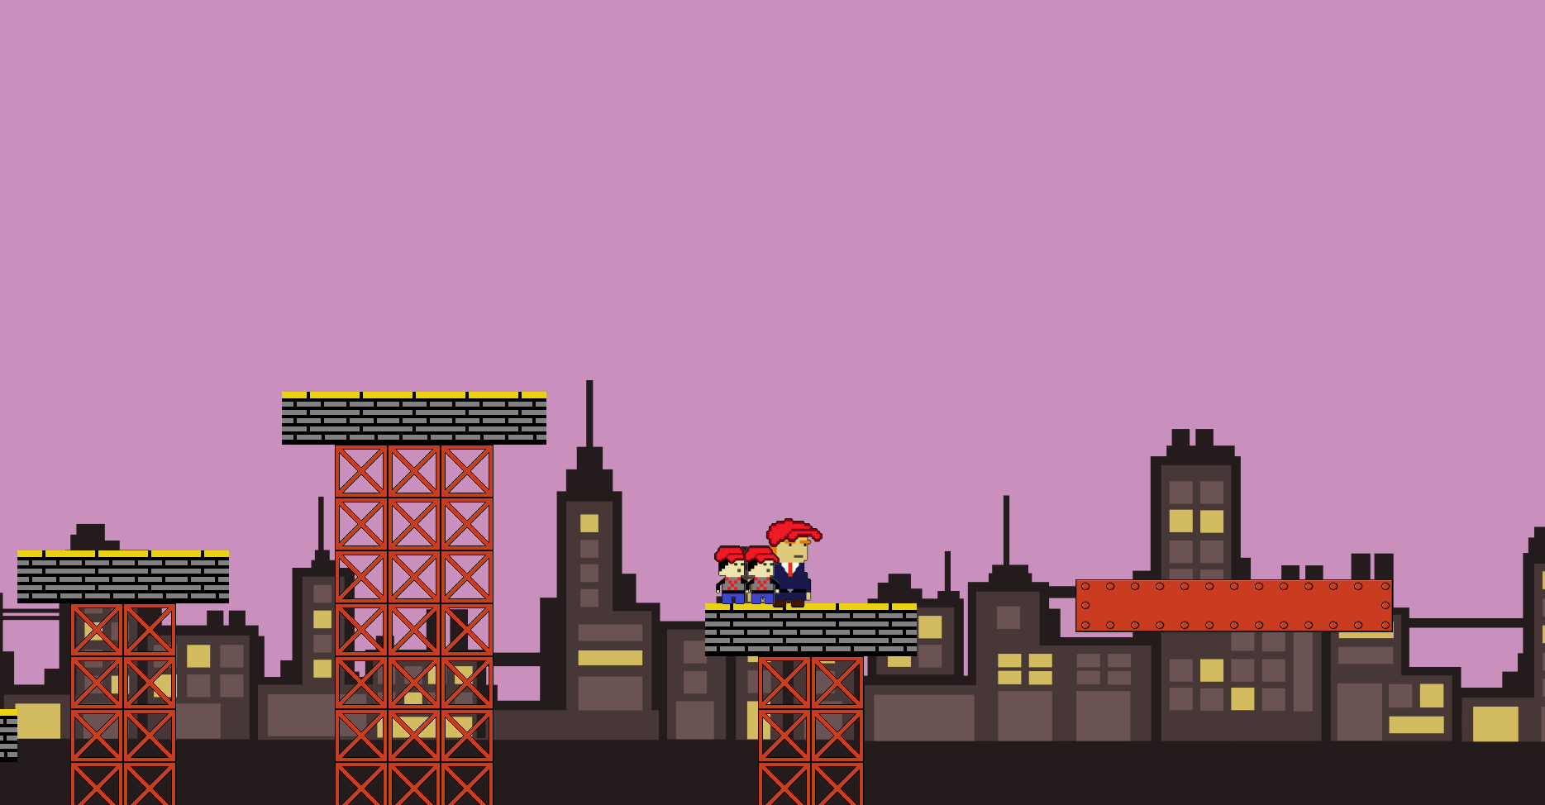
Level Design
“
”

Slide 6
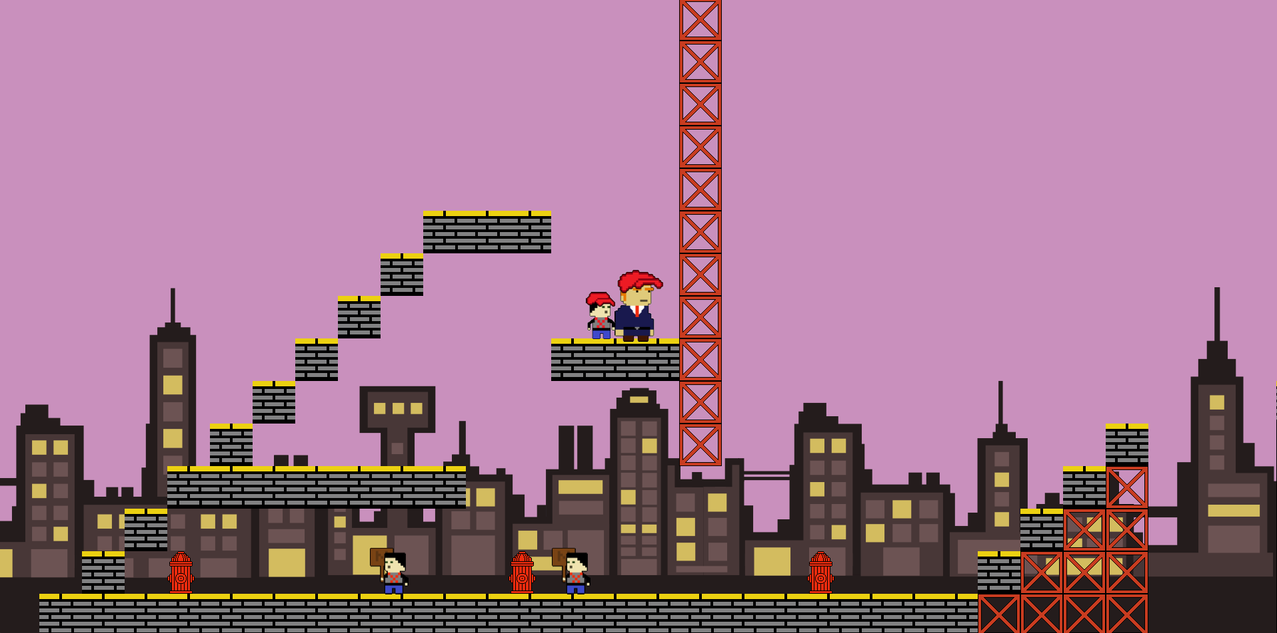
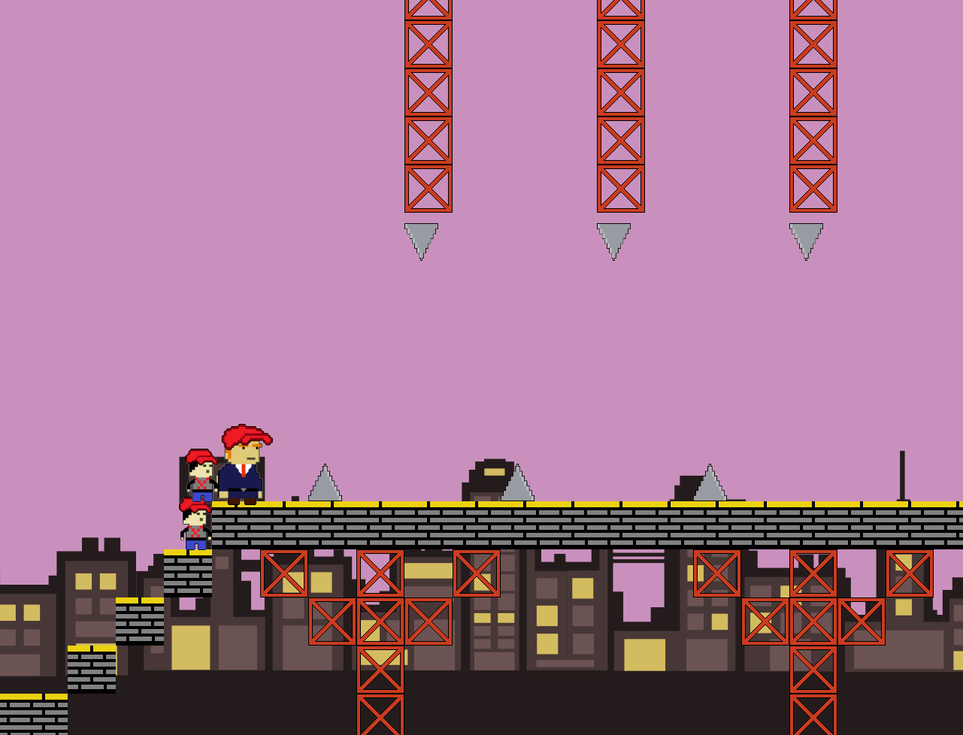
Level Design
“
”

Slide 7



Art and Style
Dennis Trumpet
Protestor
Dennis T. with Power-up
Protestor after being shot

Slide 8
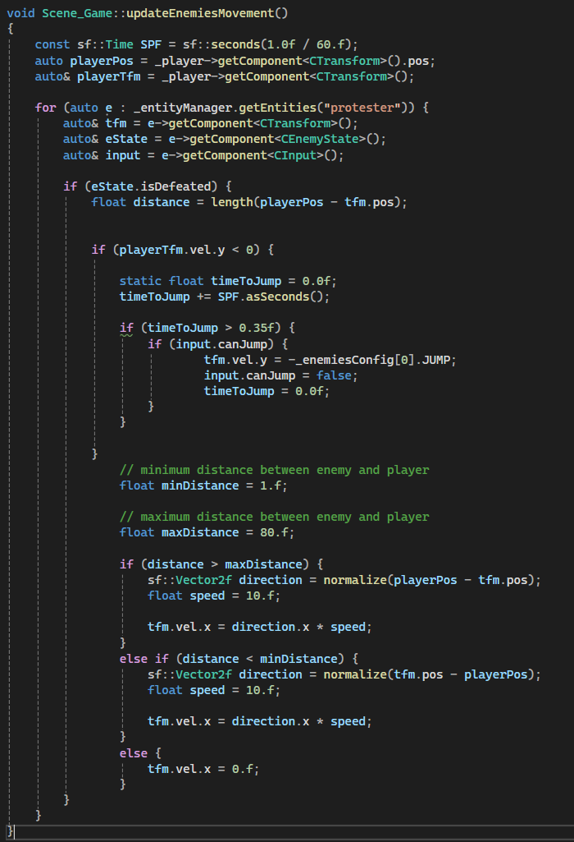
updateEnemiesMovement()
This code is responsible for moving "protester" type enemies when they are in "defeated" state.

Slide 9
Sounds Effects
MUSIC
SketchyLogic
Sounds
qubodup

Slide 10
Thank you

